Slide 1
INTRODUCTION TO SOFTWARE ENGINEERING
LECTURE - 3
FEBRUARY 13, 2017

Slide 2
AGENDA
Information systems
  Components
  Classes
  Categories
Software Engineering
  Layers
  Software process
  Process framework
  Practice
  General principles
CSD201 - Introduction to Software Engineering

Slide 3
INFORMATION SYSTEMS
Software for specific business purposes to be used by others apart from developer(s)
Software that helps to organize and analyse data
  General Purpose Information Systems
    Database Management Systems (DBMS)
    Electronic spreadsheets
  Specialized Information Systems
    ERP (Enterprise Resource Planning) systems
    GIS (Geographical Information Systems)
The systems not only facilitate business operations but also may help decision making for the management
CSD201 - Introduction to Software Engineering

Slide 4
COMPONENTS OF INFORMATION SYSTEMS
An information system would typically have the following components
  Hardware
  Software
  Databases
  Network
  Procedures
CSD201 - Introduction to Software Engineering

Slide 5
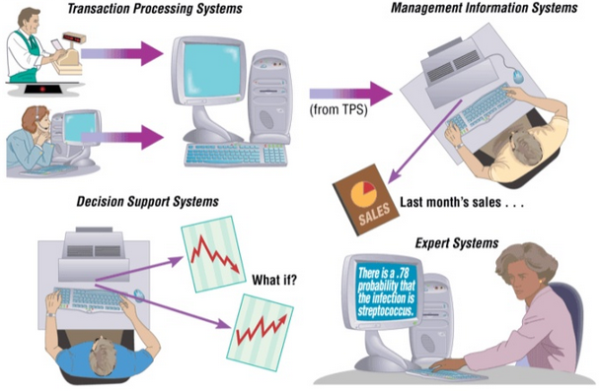
CLASSES OF INFORMATION SYSTEM
CSD201 - Introduction to Software Engineering

Slide 6
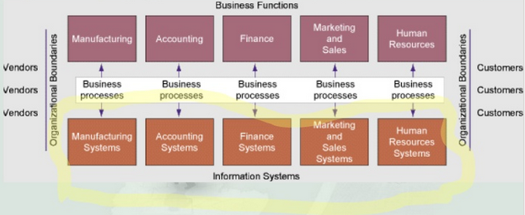
TRADITIONAL VIEW
CSD201 - Introduction to Software Engineering

Slide 7

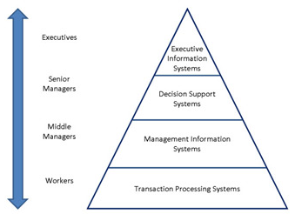
CATEGORIES OF INFORMATION SYSTEMS
CSD201 - Introduction to Software Engineering

Slide 8
SOFTWARE ENGINEERING
CSD201 - Introduction to Software Engineering

Slide 9

LAYERS OF SOFTWARE ENGINEERING
Software engineering is a layered technology
CSD201 - Introduction to Software Engineering

Slide 10
LAYERS OF SOFTWARE ENGINEERING
The foundation for software engineering is the process layer
The software engineering process is the glue that holds the technology layers together
Process defines a framework that must be established for effective delivery of software engineering technology
The software process forms the basis for management control of software projects
  Work products are produced
  Milestones are established
  Quality is ensured
  Change is managed
CSD201 - Introduction to Software Engineering

Slide 11
LAYERS OF SOFTWARE ENGINEERING
Software engineering methods provide the technical how-to’s for building software
  Methods encompass tasks that include
  Communication
  Requirements analysis
  Design modeling
  Program construction
  Testing and support
Software engineering tools provide automated or semi-automated support for the process and the methods
CSD201 - Introduction to Software Engineering

Slide 12
THE SOFTWARE PROCESS
A process is a collection of activities, actions, and tasks that are performed when some work product is to be created
  An activity is applied regardless of the application domain, size of the project
  An action includes a set of tasks that produce a major work product; e.g. an architectural model
  A task focuses on a small but well-defined objective that produces a tangible outcome; e.g. conducting a unit test
A process is not a rigid remedy. Rather, it is an adaptable approach
  It enables people to pick and choose the appropriate actions of work and tasks
CSD201 - Introduction to Software Engineering

Slide 13
THE PROCESS FRAMEWORK
A process framework establishes the foundation for a complete software engineering process by identifying a small number of framework activities that are applicable to all software project
A generic process framework encompasses five activities
  Communication
  Planning
  Modeling
  Construction
  Deployment
CSD201 - Introduction to Software Engineering

Slide 14
THE PROCESS FRAMEWORK
Umbrella activities
  Software project tracking and control
  Risk management
  Software quality assurance
  Technical reviews
  Measurement
  Software configuration management
  Reusability management
  Work product preparation and production
CSD201 - Introduction to Software Engineering

Slide 15
SOFTWARE ENGINEERING PRACTICE
The essence of software engineering practice:
  Understand the problem
  Plan a solution
  Carry out the plan
  Examine the result for accuracy
CSD201 - Introduction to Software Engineering

Slide 16
GENERAL PRINCIPLES
The reason it all exists
Keep it simple
Maintain the vision
What you produce, others will consume
Be open to the future
Plan ahead for reuse
Think
CSD201 - Introduction to Software Engineering

Slide 17
Q&A
CSD201 - Introduction to Software Engineering

